Slide 1

ALGORITHMIC TRADING
WITH QUANTCONNECT

Slide 2
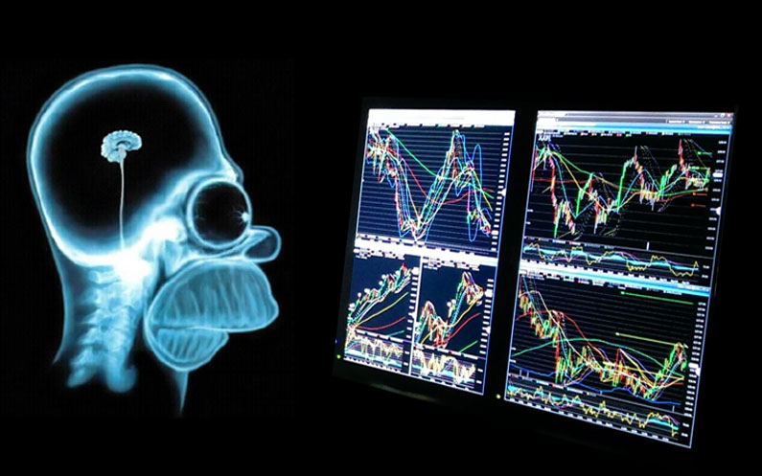
MAN V BOT

Slide 3
WHICH IS BETTER?

Slide 4
WHAT IS THE DIFFERENCE?

Slide 5

IT COMES DOWN TO…

Slide 6
EMOTIONS
VS
LOGIC

Slide 7
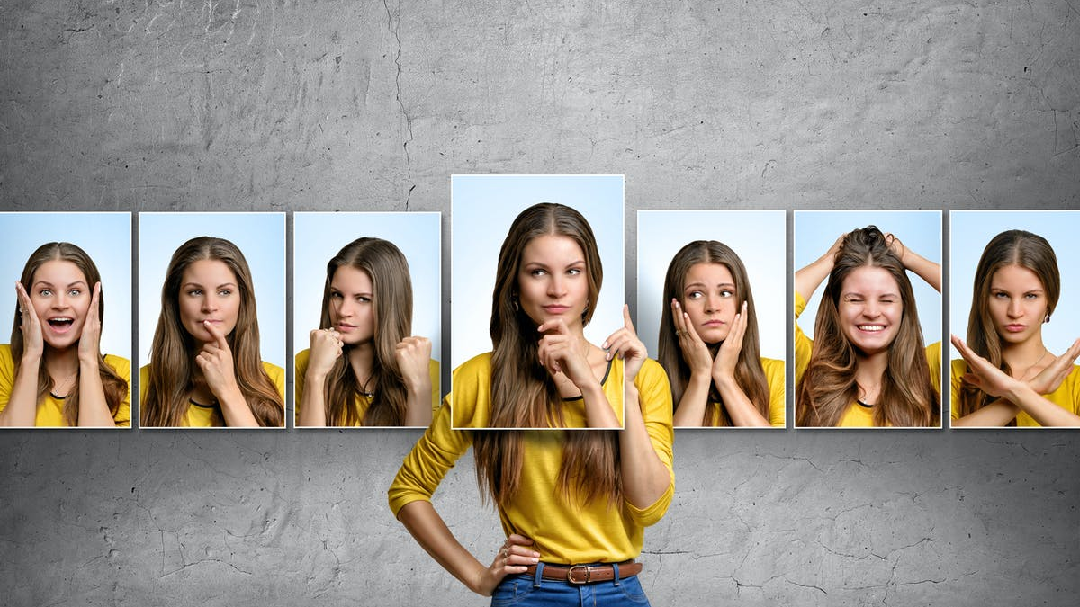
HUMANS ARE EMOTIONAL

Slide 8
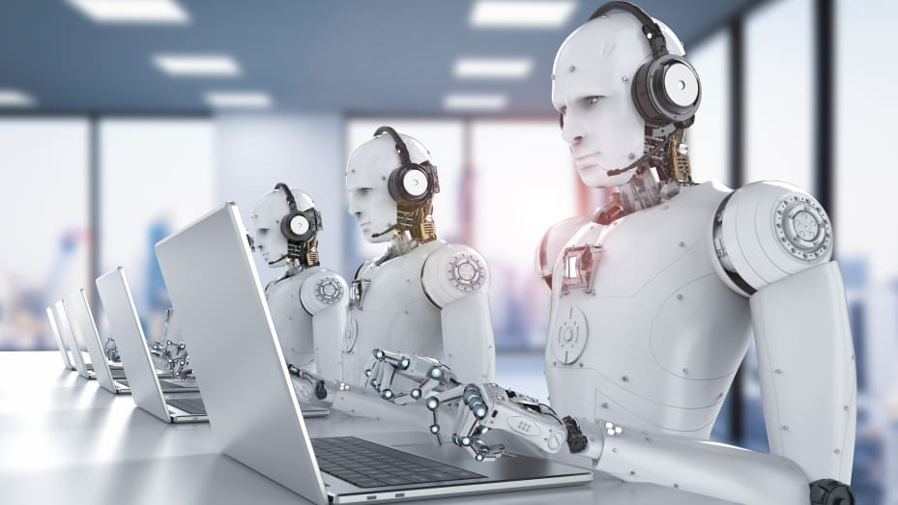
MACHINES ARE NOT

Slide 9
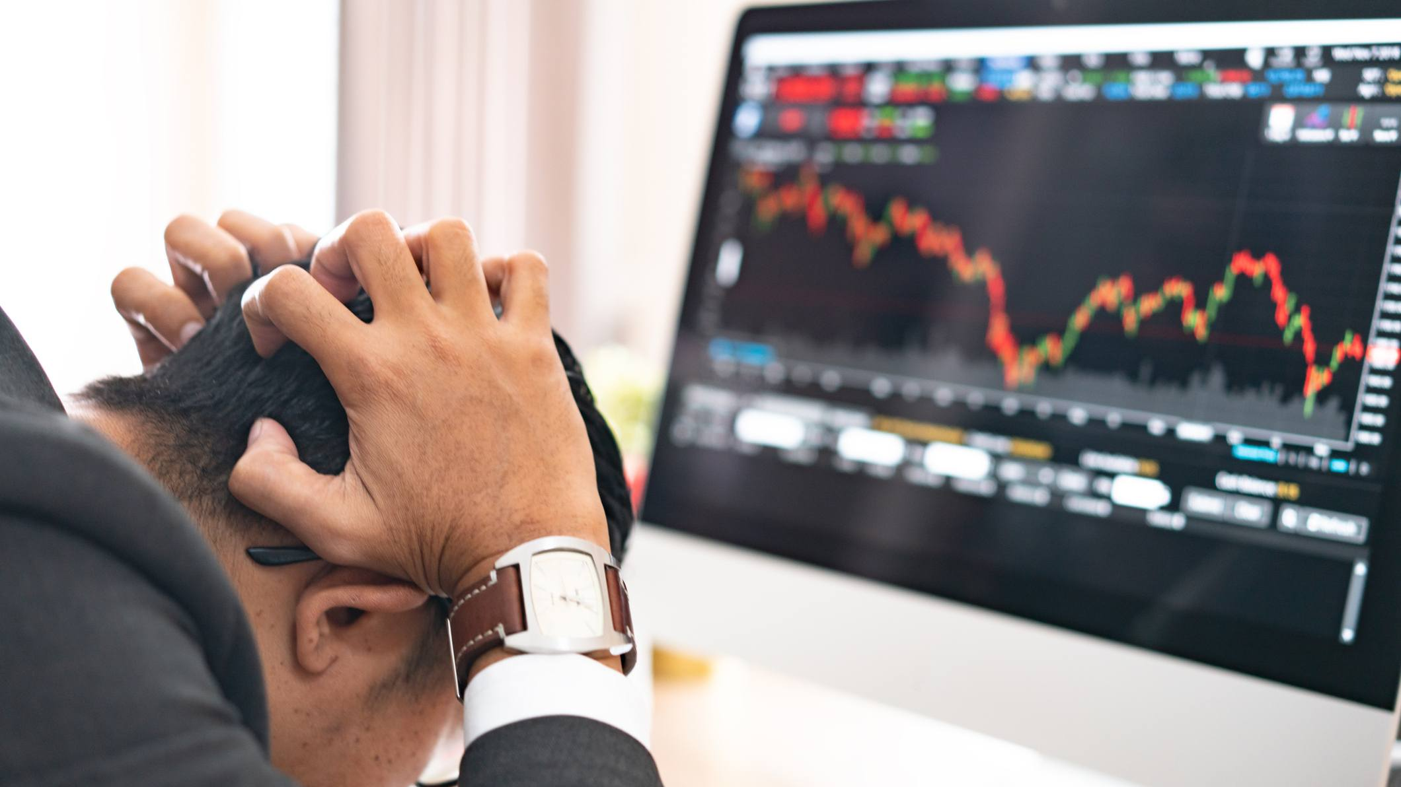
CAN WE REMOVE EMOTIONS
FROM TRADING?

Slide 10
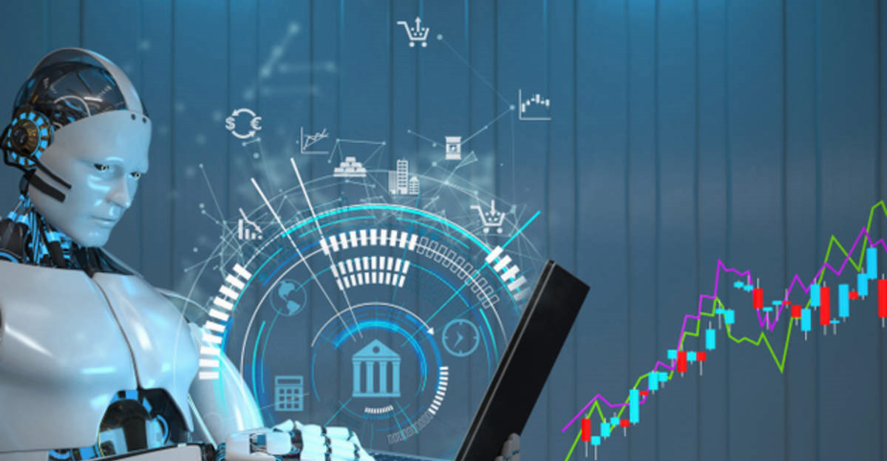
WITH ALGOS WE CAN

Slide 11
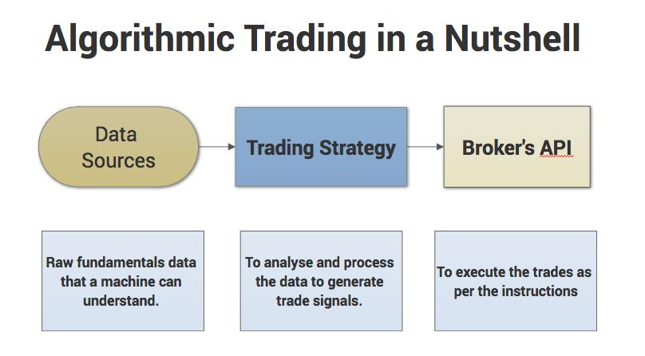

Slide 12
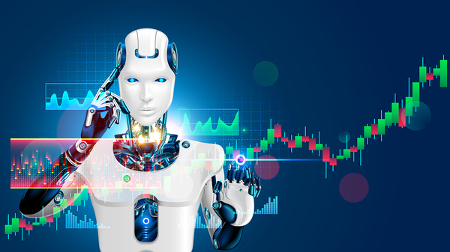
Can our algorithm beat the market by purchasing crypto when the price exceeds the models
forecasted price?
RESEARCH QUESTION

Slide 13
SO WHAT IS OUR STRATEGY?

Slide 14
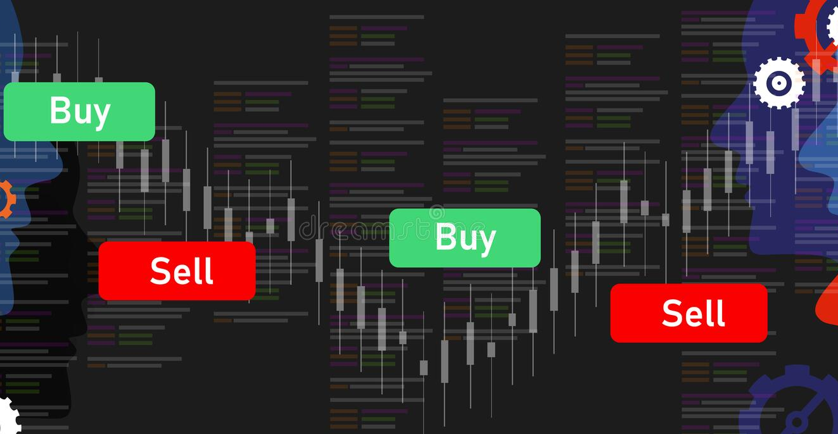
THE TREND… IS YOUR FRIEND

Slide 15
TREND TRADING - trading style that attempts to capture gains
through the analysis of an asset's momentum in a particular direction.

Slide 16
HOW DO WE ENTER OUR POSITIONS?

Slide 17
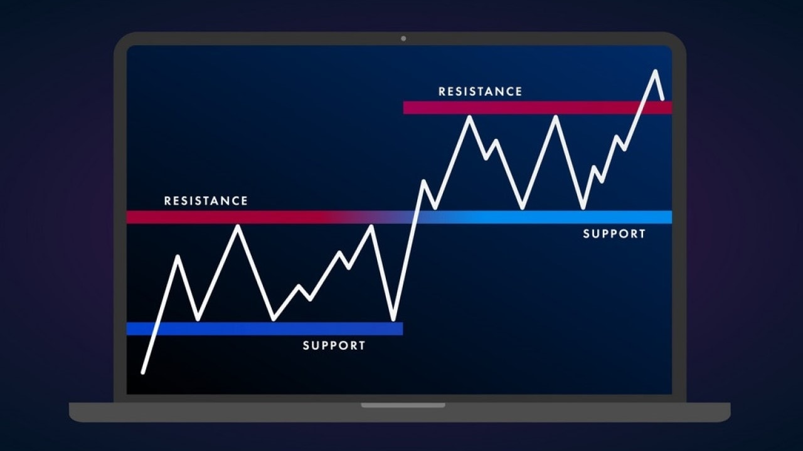
Two types of Entry Points
A BREAK in resistance
A BOUNCE off support

Slide 18
BY TRAINING THE ALGO TO ENTER A POSITION
WHEN THE PRICE IS HIGHER THAN THE PREDICTION…
IT’S SIMILAR TO ENTERING ON A BREAK OF
RESISTANCE.

Slide 19
HOW DO WE EXIT OUR POSITIONS?

Slide 20
BY TRAINING THE ALGO TO EXIT A POSITION
WHEN THE PRICE IS LOWER THAN THE PREDICTION
IT’S SIMILAR TO EXITING ON A BREAK OF
SUPPORT

Slide 21
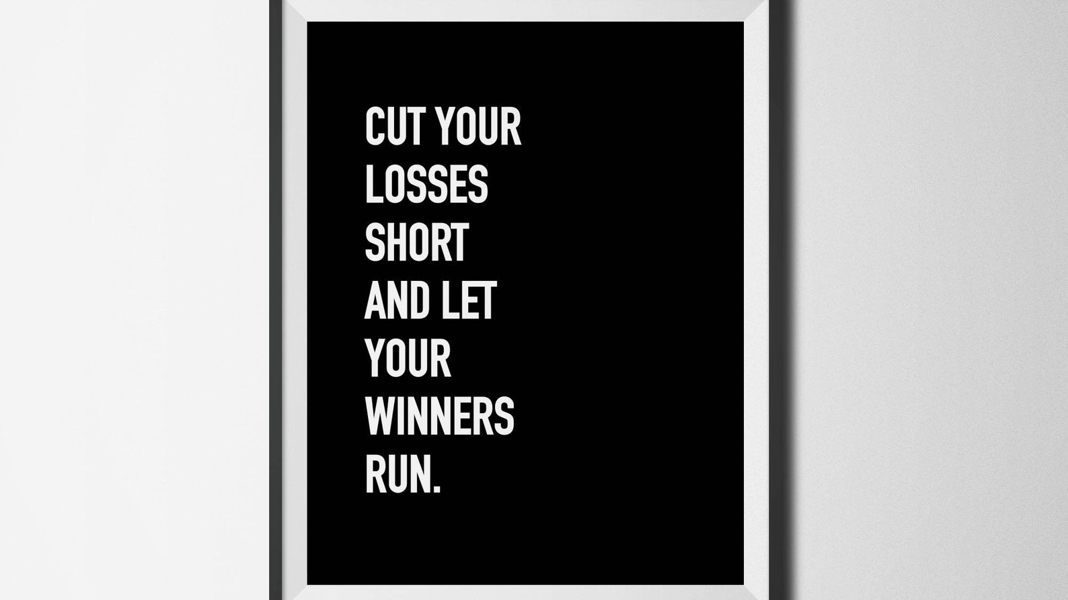

Slide 22
A COMMON TRADING STRATEGY…

Slide 23
BECOMES AUTOMATED

Slide 24
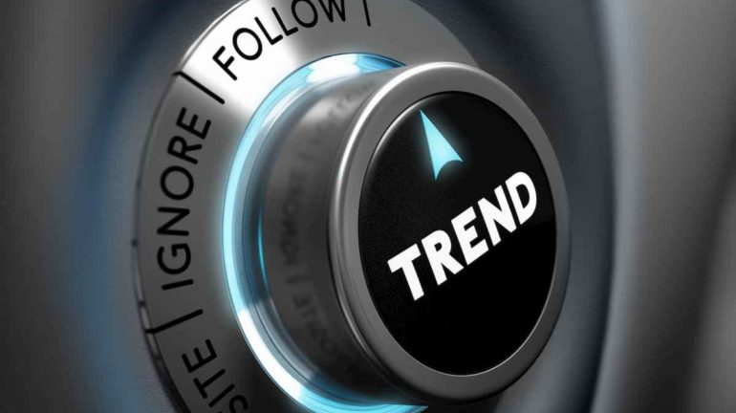

Slide 25
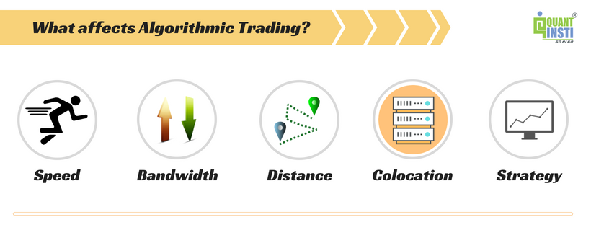
NOT ALL ALGOS ARE CREATED EQUAL

Slide 26
TUNING THE CODE
TUNING THE MODEL IN A RESEARCH NOTEBOOK
ADJUSTING THE WEIGHT'S LOGIC
ADJUSTING THE TIME WE LOOK BACK
ADDING INDICATORS
ADJUSTING THE WINDOW
ADDING MORE/DIFFERENT ASSETS

Slide 27

THANK YOU!

